Slide 1

Agile Software Development
Agile Values, Principles and Practices
SoftUni Team
Technical Trainers
Software University
http://softuni.bg

Slide 2
Table of Contents
Where did we finish?
Agile Values
Agile Principles
Agile Practices

Slide 3
Have a Question?
sli.do #Agile-2021

Slide 4

Refresher
“Agile is the ability to create and respond to change. It is a way of dealing with, and ultimately succeeding in, an uncertain and turbulent environment.”
- AgileAlliance.org

Slide 5
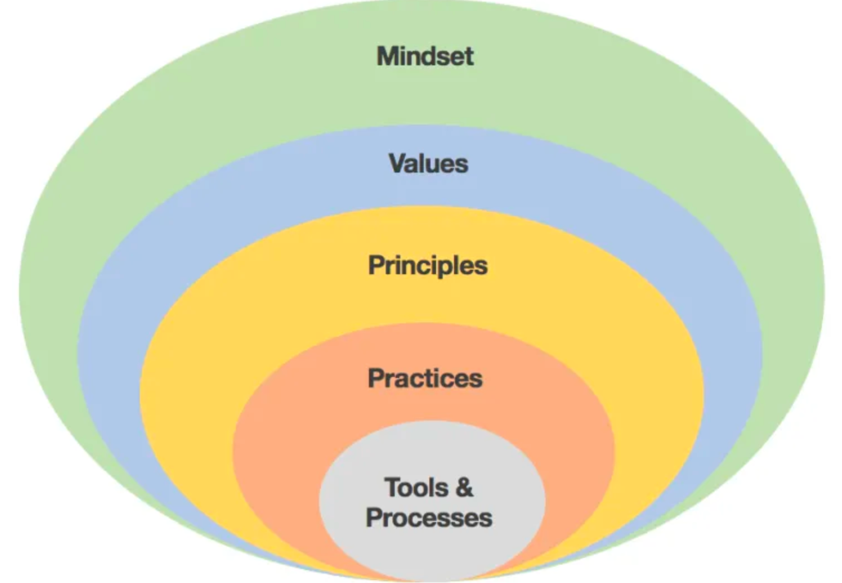
Refresher
Agile is a Mindset, Culture, Leadership Philosophy
It is built on Values, Principles and Practices
It is developed for software development, but applicable outside of it
It is developed by practitioners for practitioners
It was built on top of existing methodologies
It is still evolving
Agile is NOT a project management methodology
Agile is NOT an answer to every problem

Slide 6
Refresher
Quiz time!
sli.do #Agile-2021

Slide 7
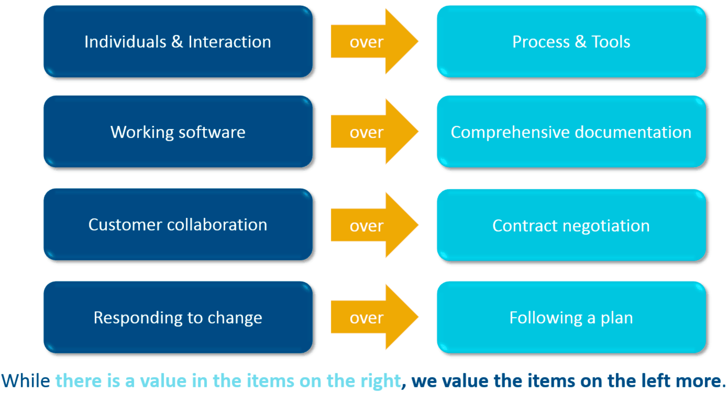
Agile Values

Slide 8
Agile Values
Daily Stand Ups
Retrospectives, Showcase, Poker Planning, Automated Testing,
Wall of Work, Social Contract and many others.
Customer Satisfaction, Welcome Changes, Frequent Delivery, Team Collaboration, Motivating Environment, Effective Communication, Working Software, Sustainability, Technical Excellence, Simplicity, Self-organizing teams, Self-Reflection
Individuals and Interactions over Processes and Tools Working Software over Comprehensive Documentation Customer Collaboration over Contract Negotiation Responding to Change over Following a Plan
Practices
Principles
Values

Slide 9
Agile Principles
Daily Stand Ups
Retrospectives, Showcase, Poker Planning, Automated Testing,
Wall of Work, Social Contract and many others.
Customer Satisfaction, Welcome Changes, Frequent Delivery, Team Collaboration, Motivating Environment, Effective Communication, Working Software, Sustainability, Technical Excellence, Simplicity, Self-organizing teams, Reflection
Individuals and Interactions over Processes and Tools Working Software over Comprehensive Documentation Customer Collaboration over Contract Negotiation Responding to Change over Following a Plan
Practices
Principles
Values

Slide 10
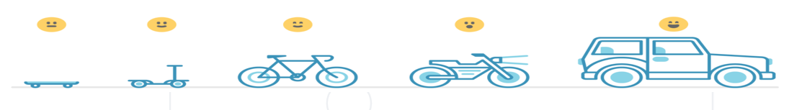
1. Customer Satisfaction
“Our highest priority is to satisfy the customer through early and continuous delivery of valuable software”
Start small
Iterative delivery
Learning from failure
Early feedback

Slide 11
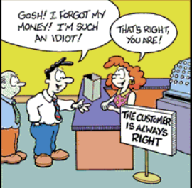
1. Customer Satisfaction
What is your view – is the customer always right?

Slide 12
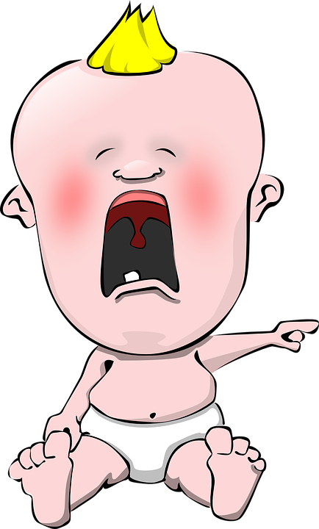
1. Customer Satisfaction
“The customer is not always right, but your job is never to show them how they’re wrong. Your job is to be professional, courteous, accommodating… and to demonstrate emotional maturity… even (and especially) under stress.”
- Steve Dorfman

Slide 13
2. Welcome Changes
“Welcome changing requirements, even late in development. Agile processes harness change for the customer’s competitive advantage.”
Notes:
Gordon Moor – Moor’s law.

Slide 14

2. Welcome Changes
“Welcome changing requirements, even late in development. Agile processes harness change for the customer’s competitive advantage.”
Why is change an important factor?
Objectives are often a moving target
Constantly increasing speed across industries
Its never too late for change…well, sometimes it might be, but still
The work cycle is also a learning curve – you cannot foresee it all
Change could be expensive, or to prevent you from getting anything done
Notes:
Gordon Moor – Moor’s law.

Slide 15

3. Frequent Delivery
“Deliver working software frequently, from a couple of weeks to a couple of months, with a preference to the shorter timescale.”
Ideally a cycle should take no longer than 4 weeks.
Be aware:
Not every company is ready to adopt such speed
Not every customer, or business is ready, or fit for that
Set realistic expectations
Good sizing might be the key

Slide 16
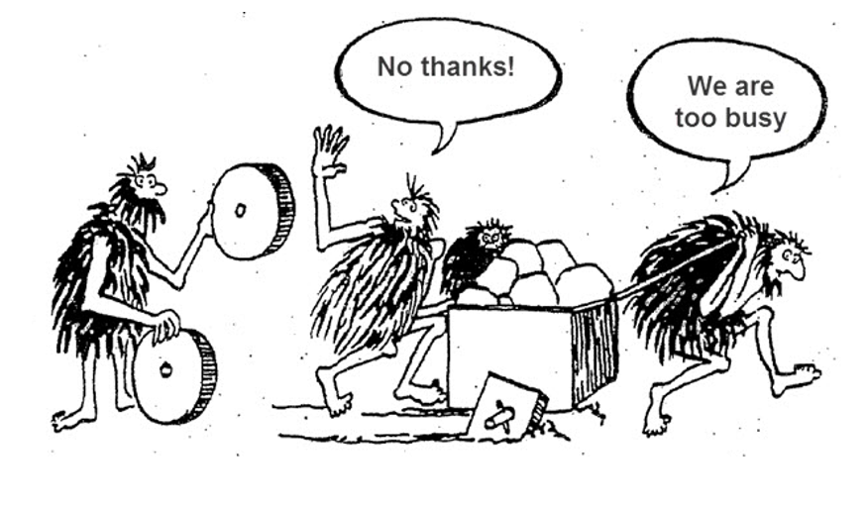
4. Team Collaboration
“Business people and developers must work together daily throughout the project.“
Creates a common knowledge
Developers get to know the business goal
Business see more about the technical background
It means a better product at the end of the cycle
It is often the best way to drive innovation

Slide 17
5. Motivating Environment
“Build projects around motivated individuals. Give them the environment and support they need, and trust them to get the job done. “
It was easy to motivate employee when building pyramids
Try not to micromanage
Motivation factors are different for every individual
In Agile setup the manager’s role is a servant role:
Support and protect the employees
Remove fear from failure
Clearly communicate the business goals
Be a caretaker
Nurtures a learning culture

Slide 18
6. Effective Communication
“The most efficient and effective method of conveying information to and within a development team is face-to-face conversation.“
Ideally all team members should be in the same location
Team Size – 2 pizzas team
Communication in Agile setup vs communication in “traditional” project management
Remote vs Onsite presence:
is “face to face” possible when the team is distributed?
can we have “pair programming” in a distributed team?

Slide 19
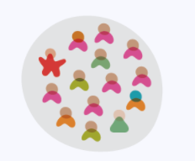
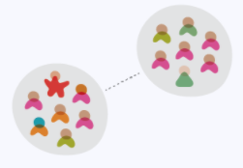
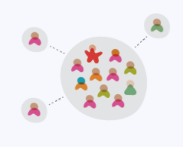
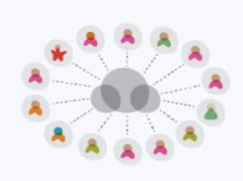
6. Effective Communication
Types of distributed teams:
Co-located
Multi-site team
Satellite workers
A remote-first
Pros and Cons of distributed teams
How to overcome the challenge?

Slide 20
7. Working Software
“Working software is the primary measure of progress.”
Software is considered as complete when it is tested and accepted by the end-user
Now the answer is simple: The feature is working. Or not!
Perfection as an enemy to progress
The minimal requirement goals are met
80% of written code does not mean anything to the customer
Working software = Successful product

Slide 21



8. Sustainability
“Agile processes promote sustainable development. The sponsors, developers, and users should be able to maintain a constant pace indefinitely. “
It is a marathon, not a one time run
Burnout is the fastest way to demotivated employees
Treat people with respect and respect the experts
Create positive stress
Notes:
Financials is not the only means for keeping people happy…actually is not even in top 3. What can keep us happy is – relationship, feeling good at what you do and sense of purpose.
The best kept secret behind the management role is that the manager should be able to allow the best out of its employees – give the time, the space…the required so they can show their best.

Slide 22
9. Technical Excellence
“Continuous attention to technical excellence and good design enhances agility.
In the software development there is a difference between “good” design and “complex” design
The same is applicable for “Technical Excellence” and “Complex Technique”
Use the right tools and frameworks
If something does not work for the project, then CHANGE it

Slide 23


10. Simplicity
“Simplicity--the art of maximizing the amount of work not done--is essential.”
Work smart
Leveraging technology and accumulated knowledge
Domain knowledge and customer needs
Notes:
The middle part of this principle “maximizing the amount of work not done” is harder. When implementing agility in an organization this is the cause of discussion. Maximizing the work not done implies that the agile method will skip some processes, code and steps that where necessary in the traditional way of delivering software. This is where agile is linked with Lean. Lean focuses on reducing waste and creating a lean process. Work not done (that was planned to do) with the same end-value, can be classified as waste. In a discussion about work not done, you ask the person asking the question to specify the added business value of the work relative to other tasks. When the added value is not clear this is probably waste. Here you have to discuss the added value of intensive review sessions, bureaucratic procedures, complex frameworks and other corporate rules we meet every day.

Slide 24
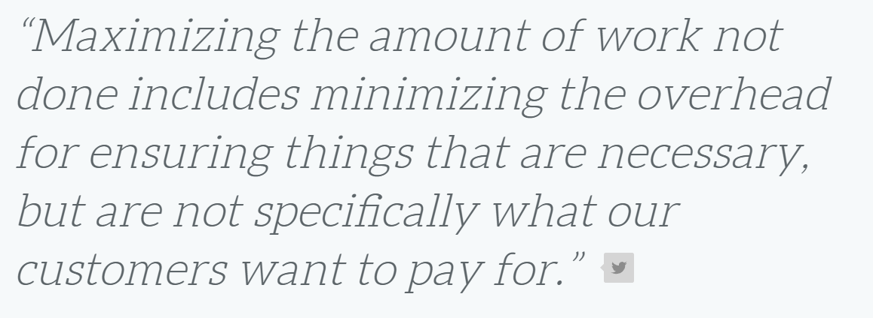
10. Simplicity

Slide 25

11. Self-organizing teams
“The best architectures, requirements, and designs emerge from self-organizing teams.”
Does self-organizing mean “running wild”?
Micro-management kills innovation
Allow employees to show their full potential
Create a culture of trust
Reduced number of approvals
Give space for learning new things

Slide 26
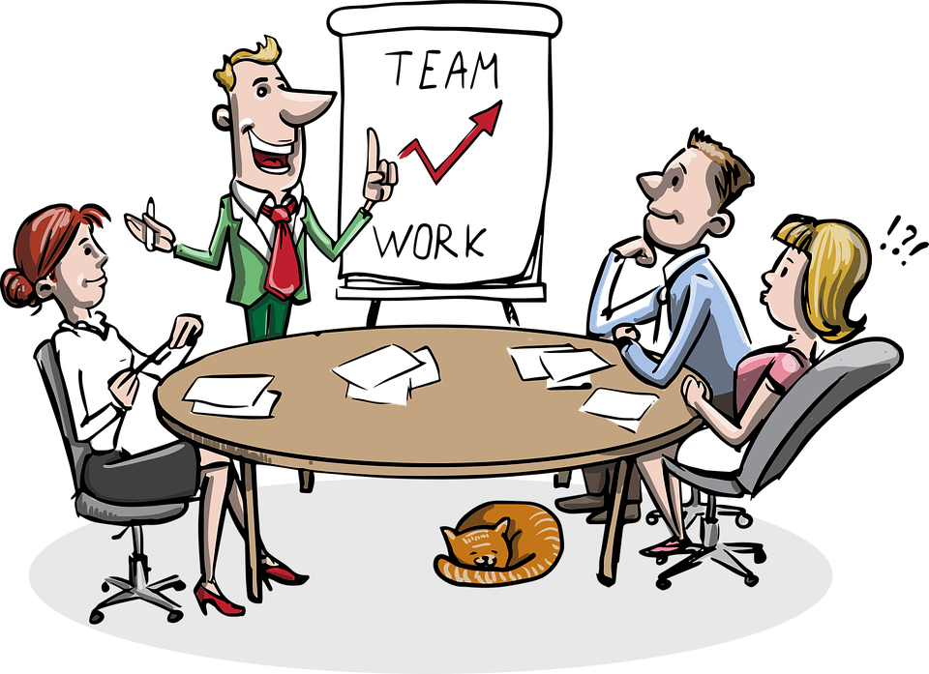
12. Reflection
“At regular intervals, the team reflects on how to become more effective, then tunes and adjusts its behavior accordingly.”

Slide 27

12. Reflection
You need to look yourself in the mirror on a regular basis
Reflect as a team
Do it after each iteration
Do it together with the customer
It is the only way to become better
Learn from failure
Be honest… have a courage… drive the change

Slide 28
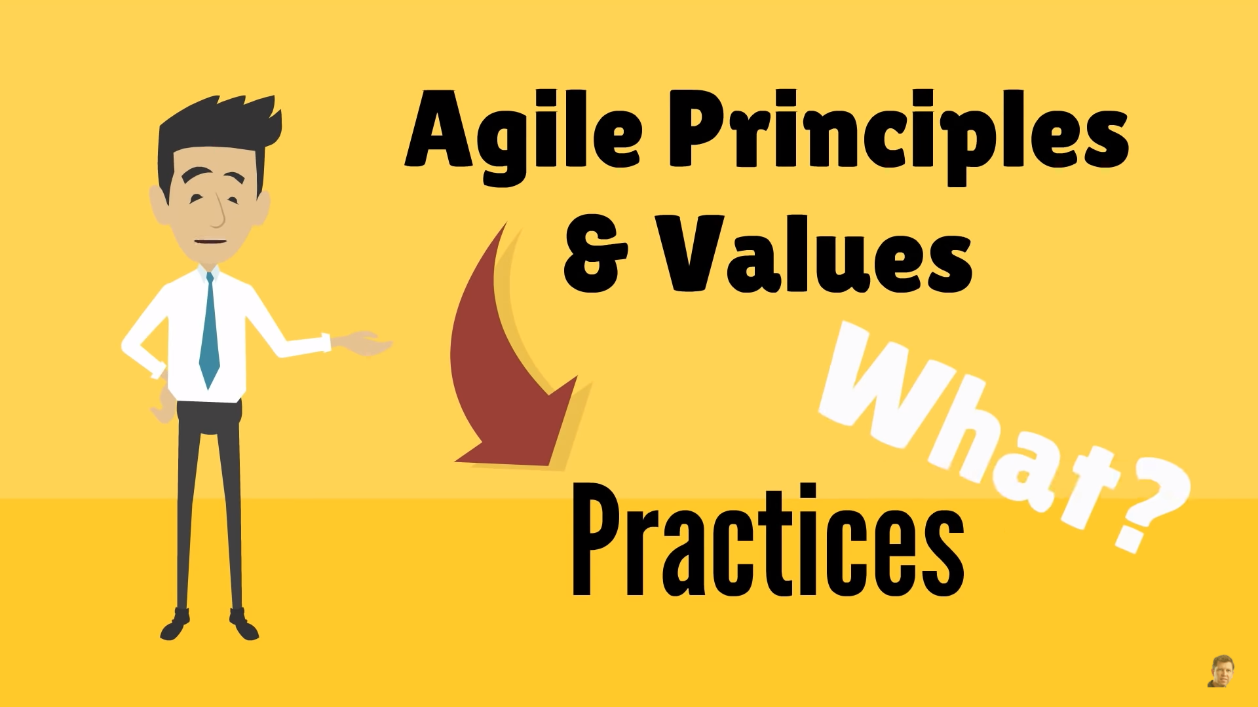
Agile Practices

Slide 29
Agile Principles
Daily Stand Ups
Retrospectives, Showcase, Poker Planning, Automated Testing,
Wall of Work, Social Contract and many others.
Customer Satisfaction, Welcome Changes, Frequent Delivery, Team Collaboration, Motivating Environment, Effective Communication, Working Software, Sustainability, Technical Excellence, Simplicity, Self-organizing teams, Reflection
Individuals and Interactions over Processes and Tools Working Software over Comprehensive Documentation Customer Collaboration over Contract Negotiation Responding to Change over Following a Plan
Practices
Principles
Values

Slide 30
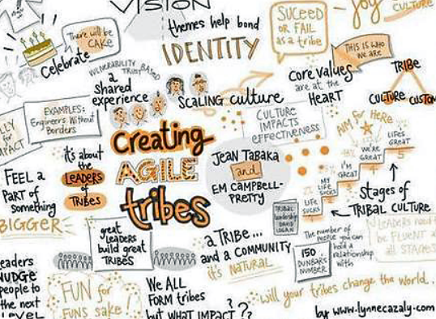
Agile Practices
The Agile practices are the building blocks of any Agile setup
Various practices are used to ensure that any Agile project is successful
Practices are chosen by the Agile change agent or team to fit in the specific requirements of the context
There is no specific set one should use. Every project is unique, hence the practices to be used could vary
Many of the practices are not newly invented. Many of them originate from methodologies such as: Scrum, Kanban, XP and others

Slide 31
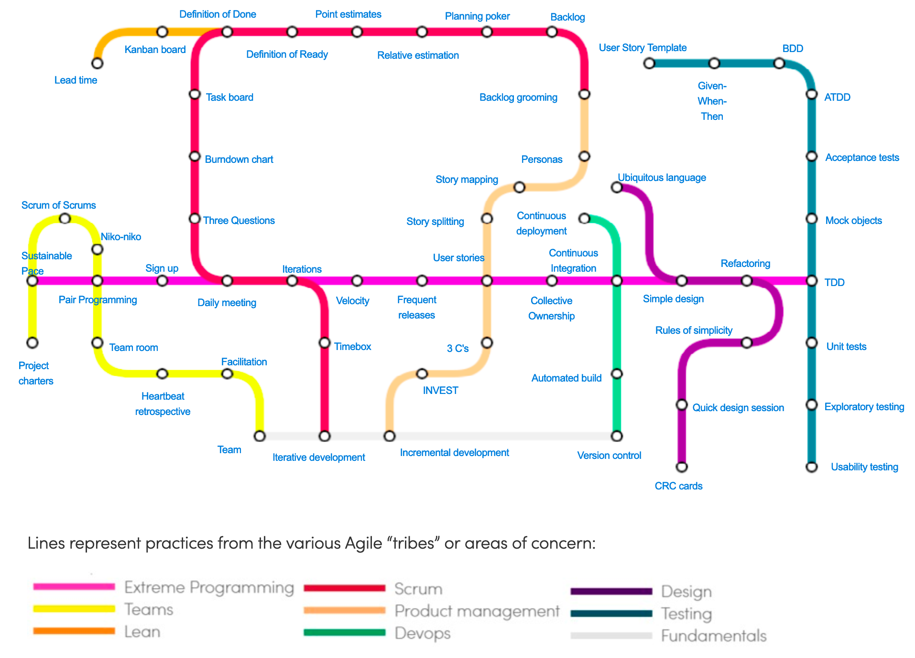
Subway Map to Agile Practices

Slide 32
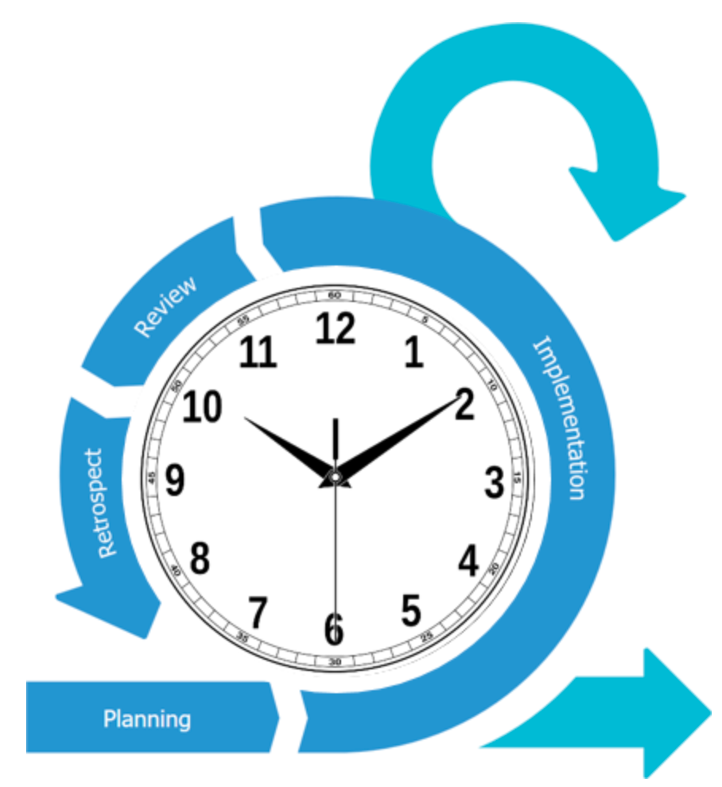
Timebox
A timebox is a previously agreed period of time during which a person or a team works steadily towards completion of some goal. Rather than allow work to continue until the goal is reached, and evaluating the time taken, the timebox approach consists of stopping work when the time limit is reached and evaluating what was accomplished.

Slide 33
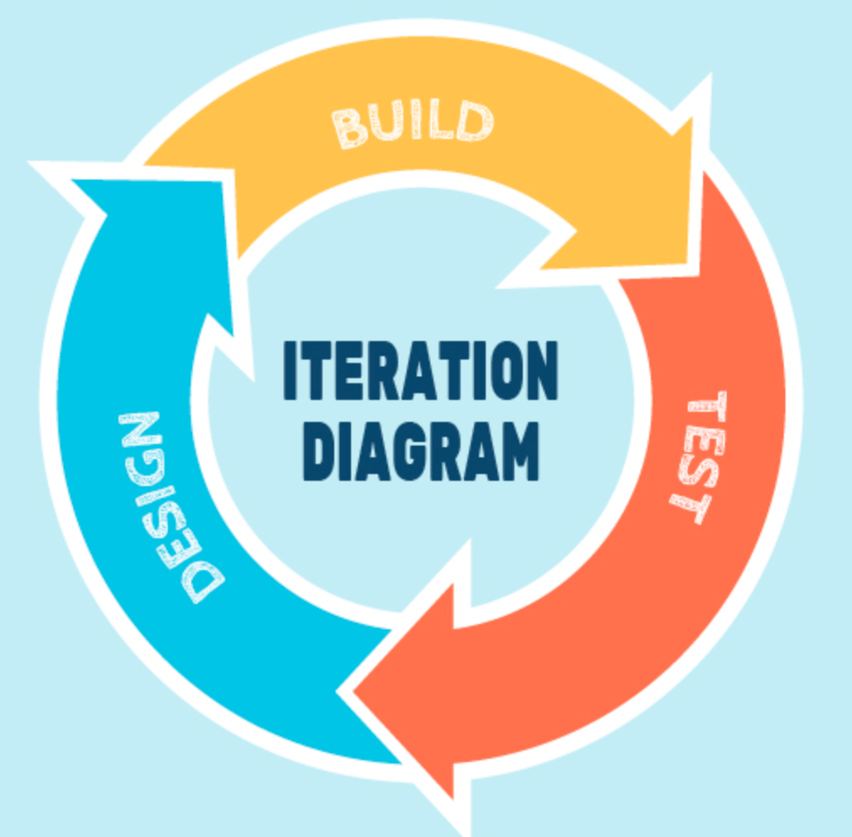
Iteration
An iteration, in the context of an Agile project, is a timebox during which development takes place, the duration of which:
may vary from project to project, usually between 1 and 4 weeks
is in most cases fixed for the duration of a given project

Slide 34
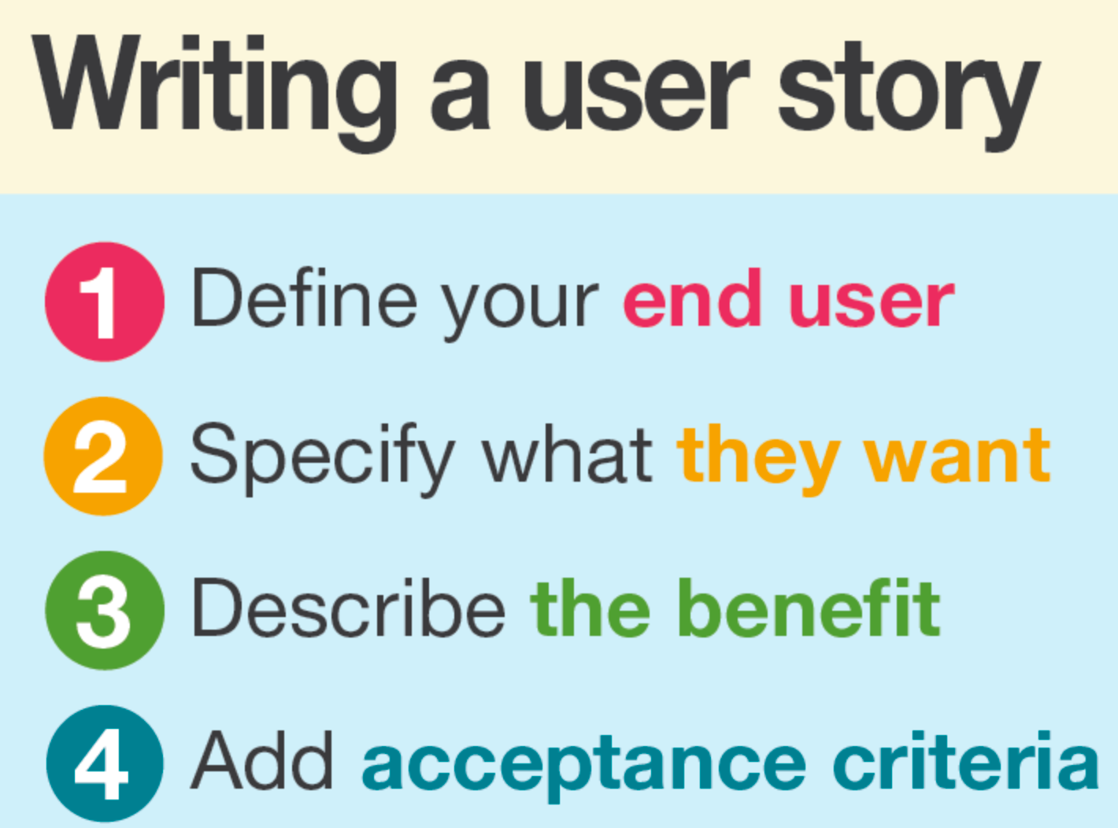
User Stories
In consultation with the customer or product owner, the team divides up the work to be done into functional increments called “user stories.”
Each user story is expected to yield, once implemented, a contribution to the value of the overall product, irrespective of the order of implementation.

Slide 35
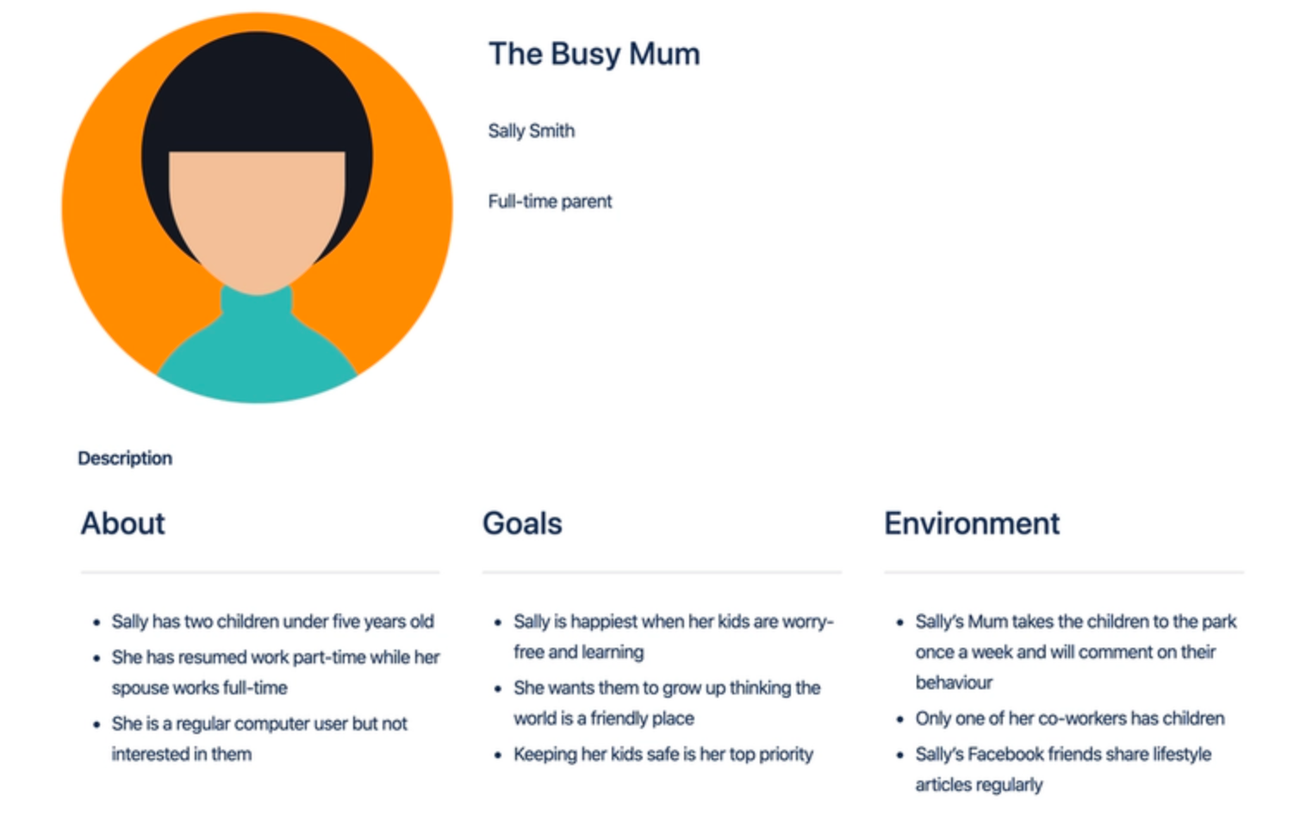
Personas
When the project calls for it – for instance when user experience is a major factor in project outcomes – the team crafts detailed, synthetic biographies of fictitious users of the future product: these are called “personas”. (In Alan Cooper’s concise terms: “make up pretend users and design for them”.)

Slide 36
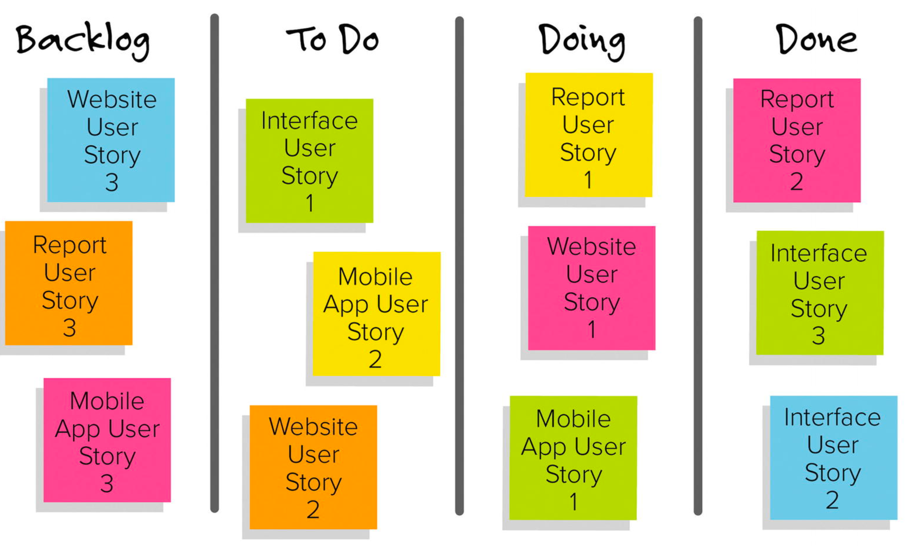
Backlog
A product backlog is a list of the new features, changes to existing features, bug fixes, infrastructure changes or other activities that a team may deliver in order to achieve a specific outcome.

Slide 37
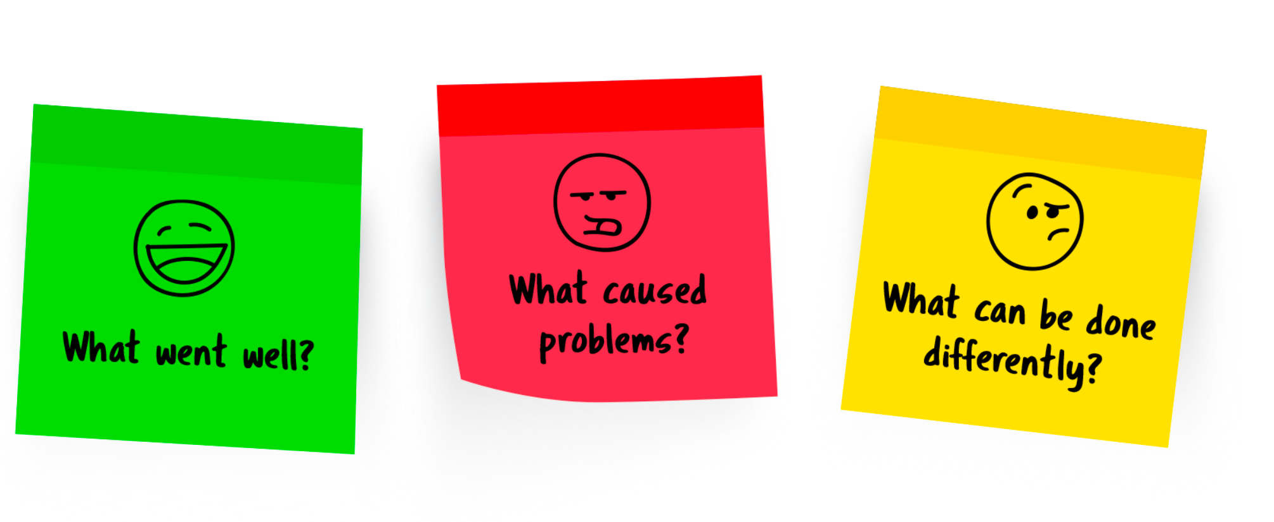
Retrospective
The team meets regularly, usually adhering to the rhythm of its iterations, to explicitly reflect on the most significant events to have occurred since the previous such meeting, and take decisions aiming at remediation or improvement.

Slide 38
Key Factors for Success
Agile Is Iterative And Incremental
Time Boxed
Focused On Minimum Marketable Features (MMFs)
Continuous User Feedback
Open To Change
Visual
Measurable

Slide 39
Key Agile Concepts - Homework
Acceptance Testing
ATDD
Backlog
Backlog Grooming
BDD
Continuous Deployment
Continuous Integration
Definition of Done
Definition of Ready
Exploratory Testing
Given When Then
Incremental Development
Iterative Development
Kanban
Kanban Board
Pair Programming
Planning Poker
Product Owner
Scrum
Scrum Master
Story Mapping
TDD
Timebox
Ubiquitous Language
Unit Testing
Usability TestingUser Stories
3 C’s

Slide 40

Summary
Agile is not a methodology which can be simply followed
Whatever you do, keep the values and principles in mind
Practices are there to support the values and principles of Agile
Don’t follow blindly, but THINK!
…
…
…

Slide 42













SoftUni Diamond Partners

Slide 43




SoftUni Organizational Partners

Slide 44





Trainings @ Software University (SoftUni)
Software University – High-Quality Education, Profession and Job for Software Developers
softuni.bg
Software University Foundation
http://softuni.foundation/
Software University @ Facebook
facebook.com/SoftwareUniversity
Software University Forums
forum.softuni.bg

